Slide 1

Image Processing:Team Project2
Perfect Pitch
Final Report
Team 02 16 (Perfect pitch)
20141001 이지호 20141261 송제웅
20164542김선재 20145315 심지선
2018. 12. 08 (SAT)

Slide 2
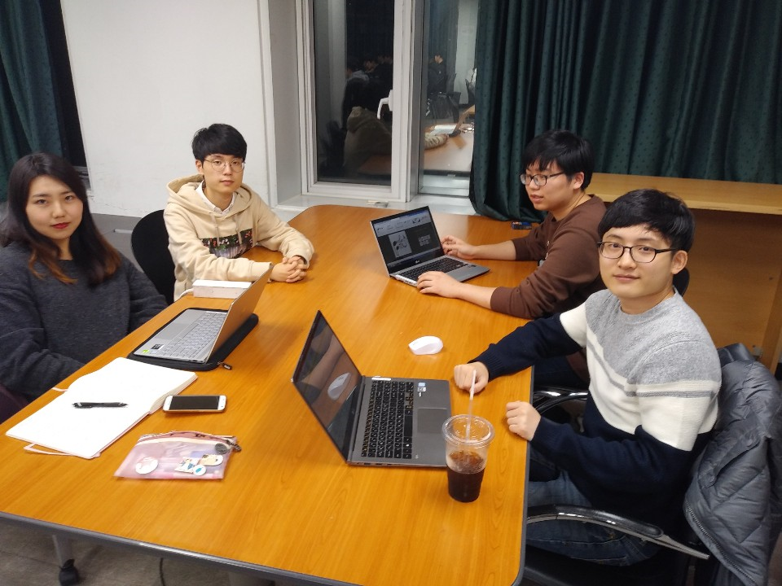
Introduction: Team Member Introduction
Team 02 16 Perfect pitch
전자전기공학과 김선재
컴퓨터공학과 이지호
컴퓨터공학과 송제웅
경영학과 심지선
Team Leader!
First Meeting (Nov.12)

Slide 3
CONTENTS
Outline
Overview
Main Functions
Design
Class
UI
Performance
Spending Time
Demo

Slide 4
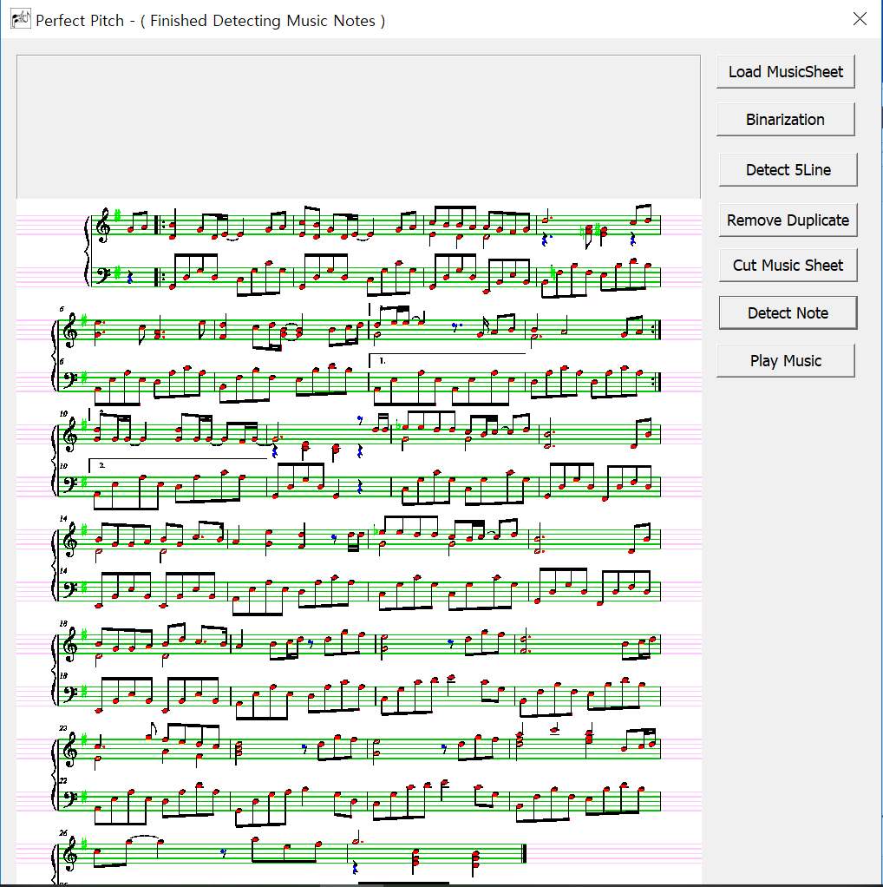
Outline : Overview – Project description and Screenshots
Perfect Pitch
Recognize the notes
&
Turn to Music
Sound

Slide 5
Outline : Overview – Process of Music Sheet Detection
Pretreatment
Binarization
Detect 5 line
Process Music Scores
Detect Head / Rest symbol
Detect musical symbol
Calculate Pitch
Compare Linearly (x coordinates)
Push to Accord (thread)
Remove Duplicate
Cut Staves
Detect Beat
Detect dot ( 1+1/2 beat)
Play Music by Using Midi

Slide 6
Main Function: Pretreatment
Pretreatment

Slide 7
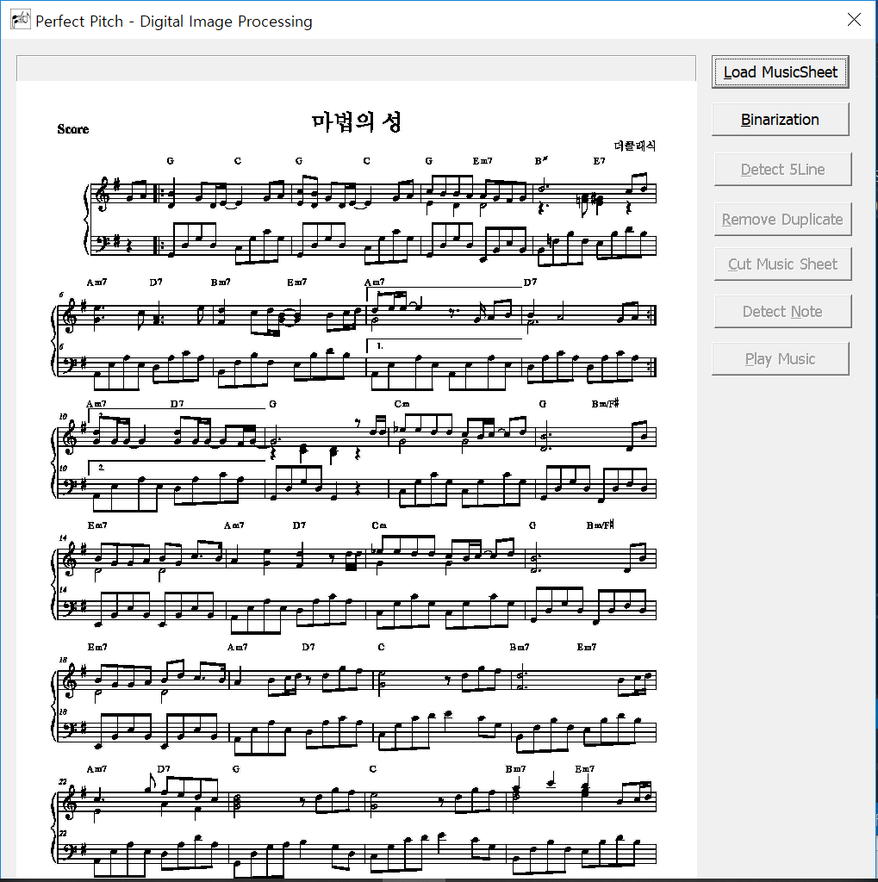
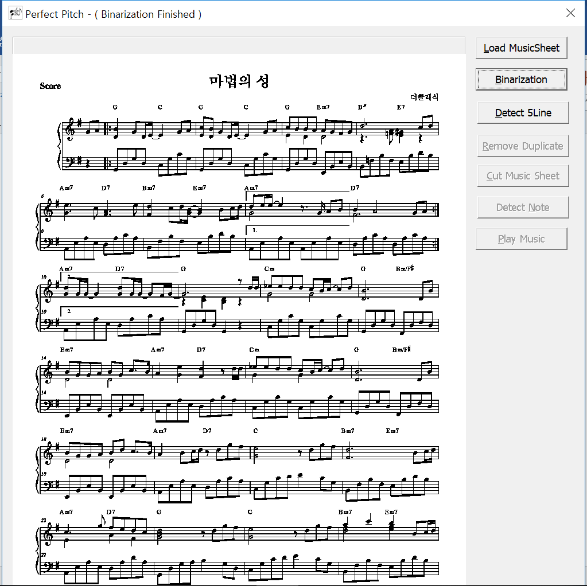
Main Function: Binarization
Before
After

Slide 8
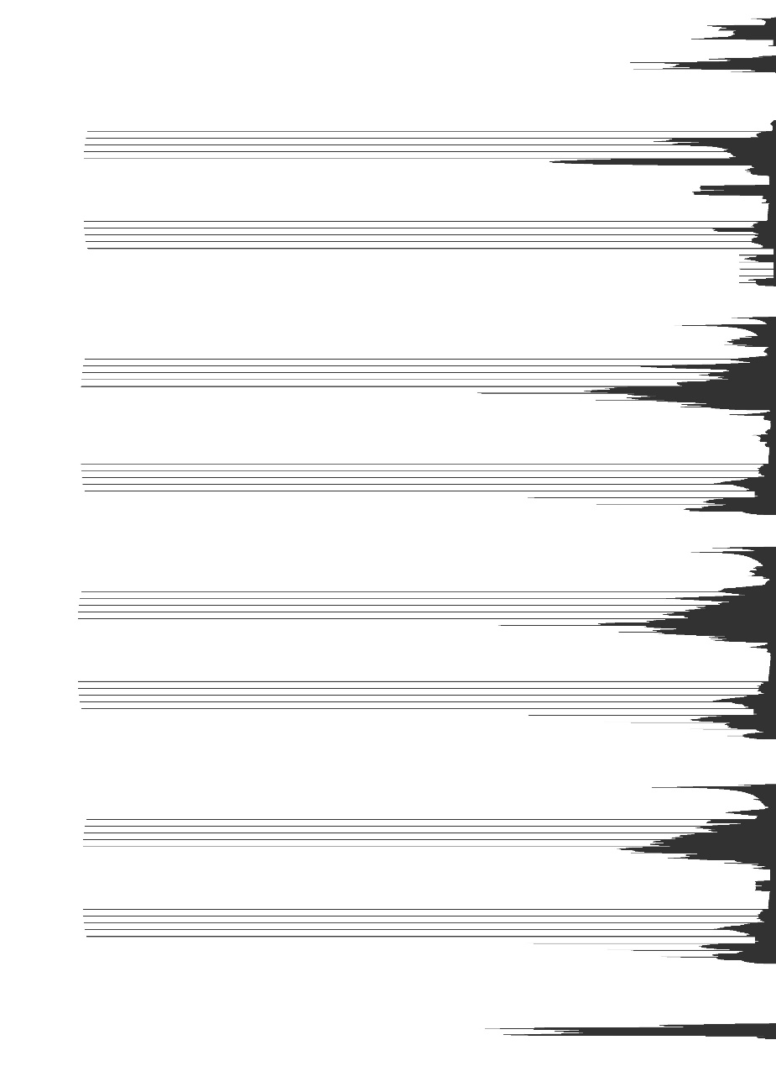
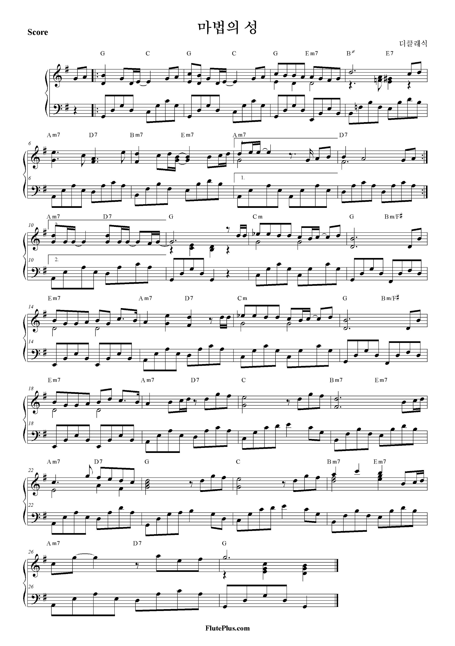
Main Function : Detect 5 Lines
Calculate
Histogram

Slide 9
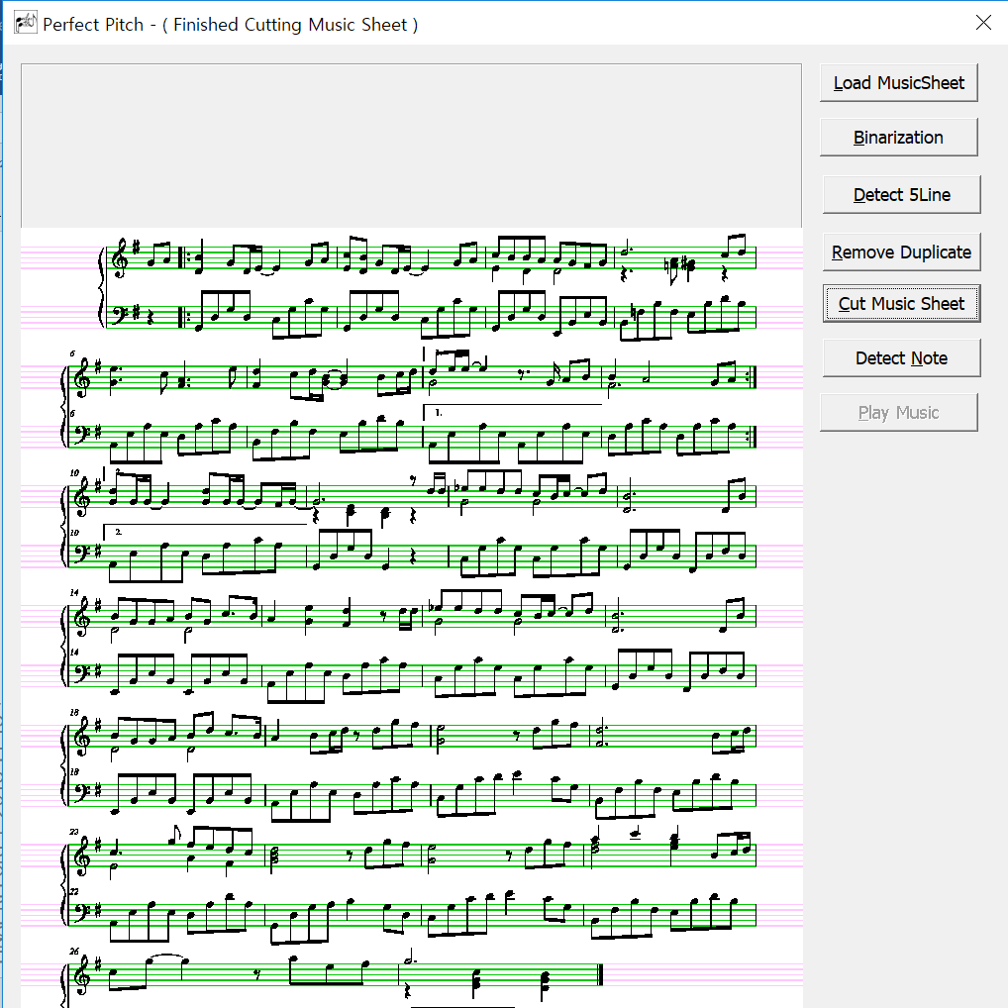
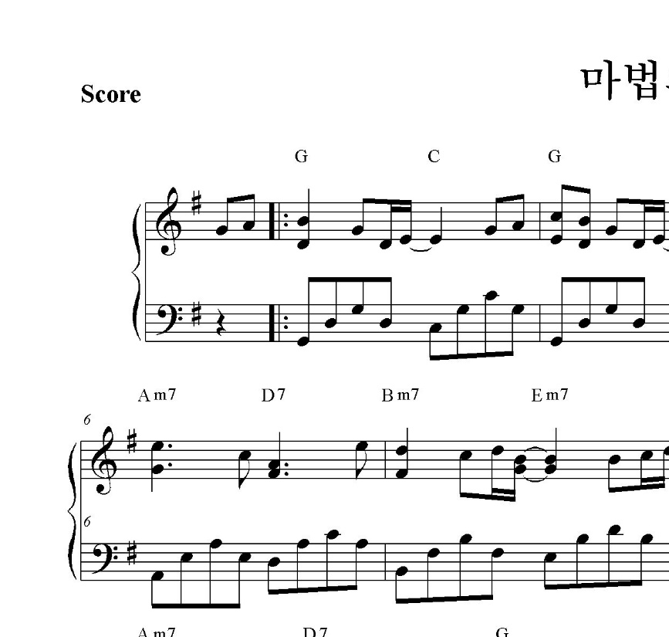
Main Function : Cutting Staves
1
2
3
4
5
6
7
8
9
10
11
12
13
14

Slide 10
Main Function: Process Music Scores
Process Music Scores

Slide 11
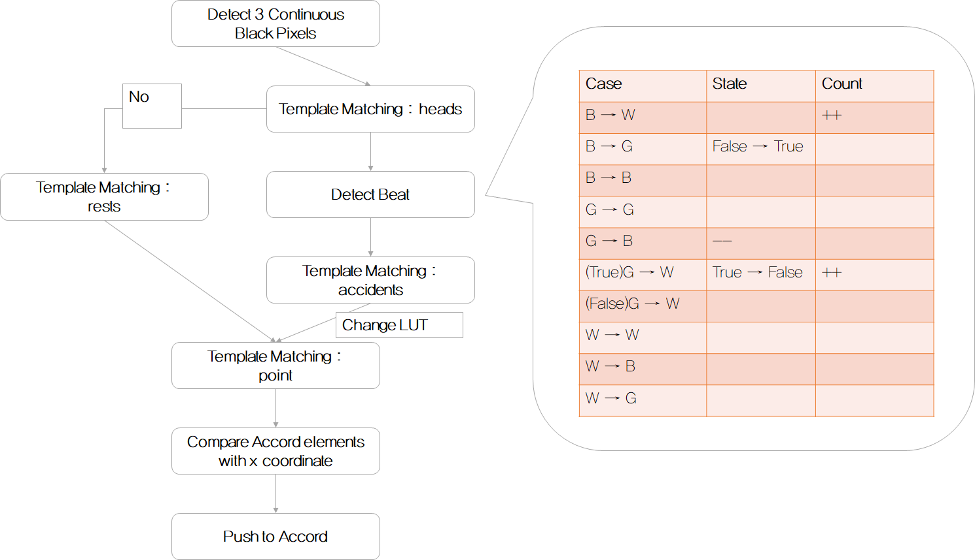
Main Function :Flowchart of Processing Music Scores

Slide 12
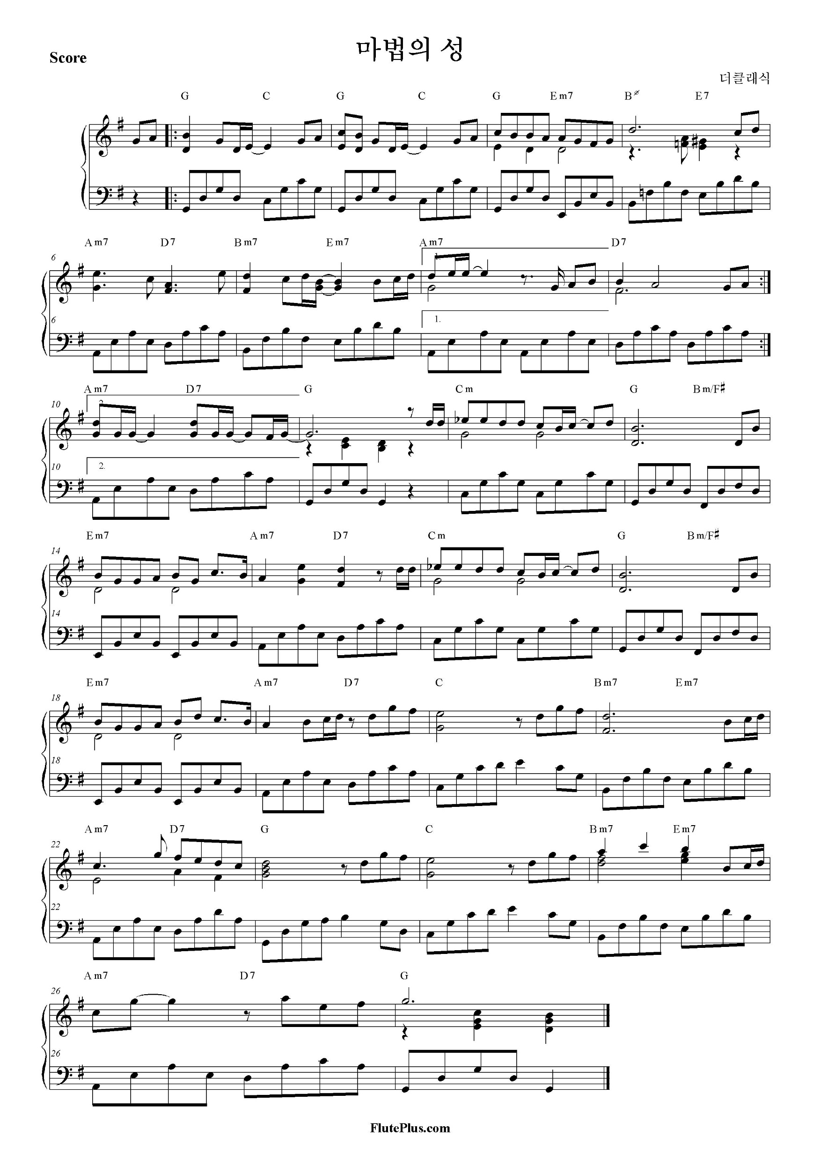
Main Function :Template Matching

Slide 13
Main Text :Template Matching
1) Detecting Heads
2) Distinguish UP/Down Notes and Stems
Bottom
Rest
Up

Slide 14
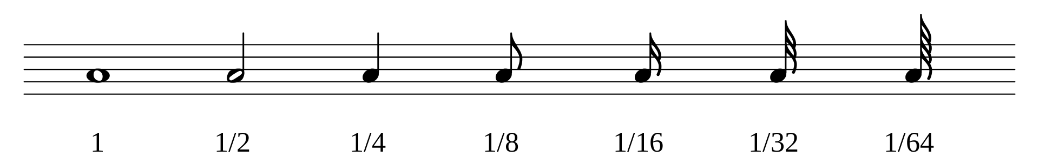
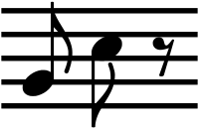
Main Function :Detect Beat
3) Flag Navigation (Beat Detection)

Slide 15
Main Text :Template Match
4) Detecting and Processing Sharp,
Flat and Natural

Slide 16
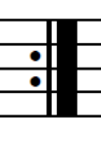
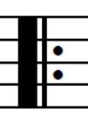
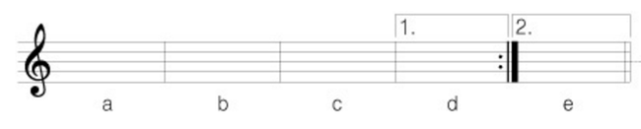
Main Function :Detect Repeat Mark

Slide 17
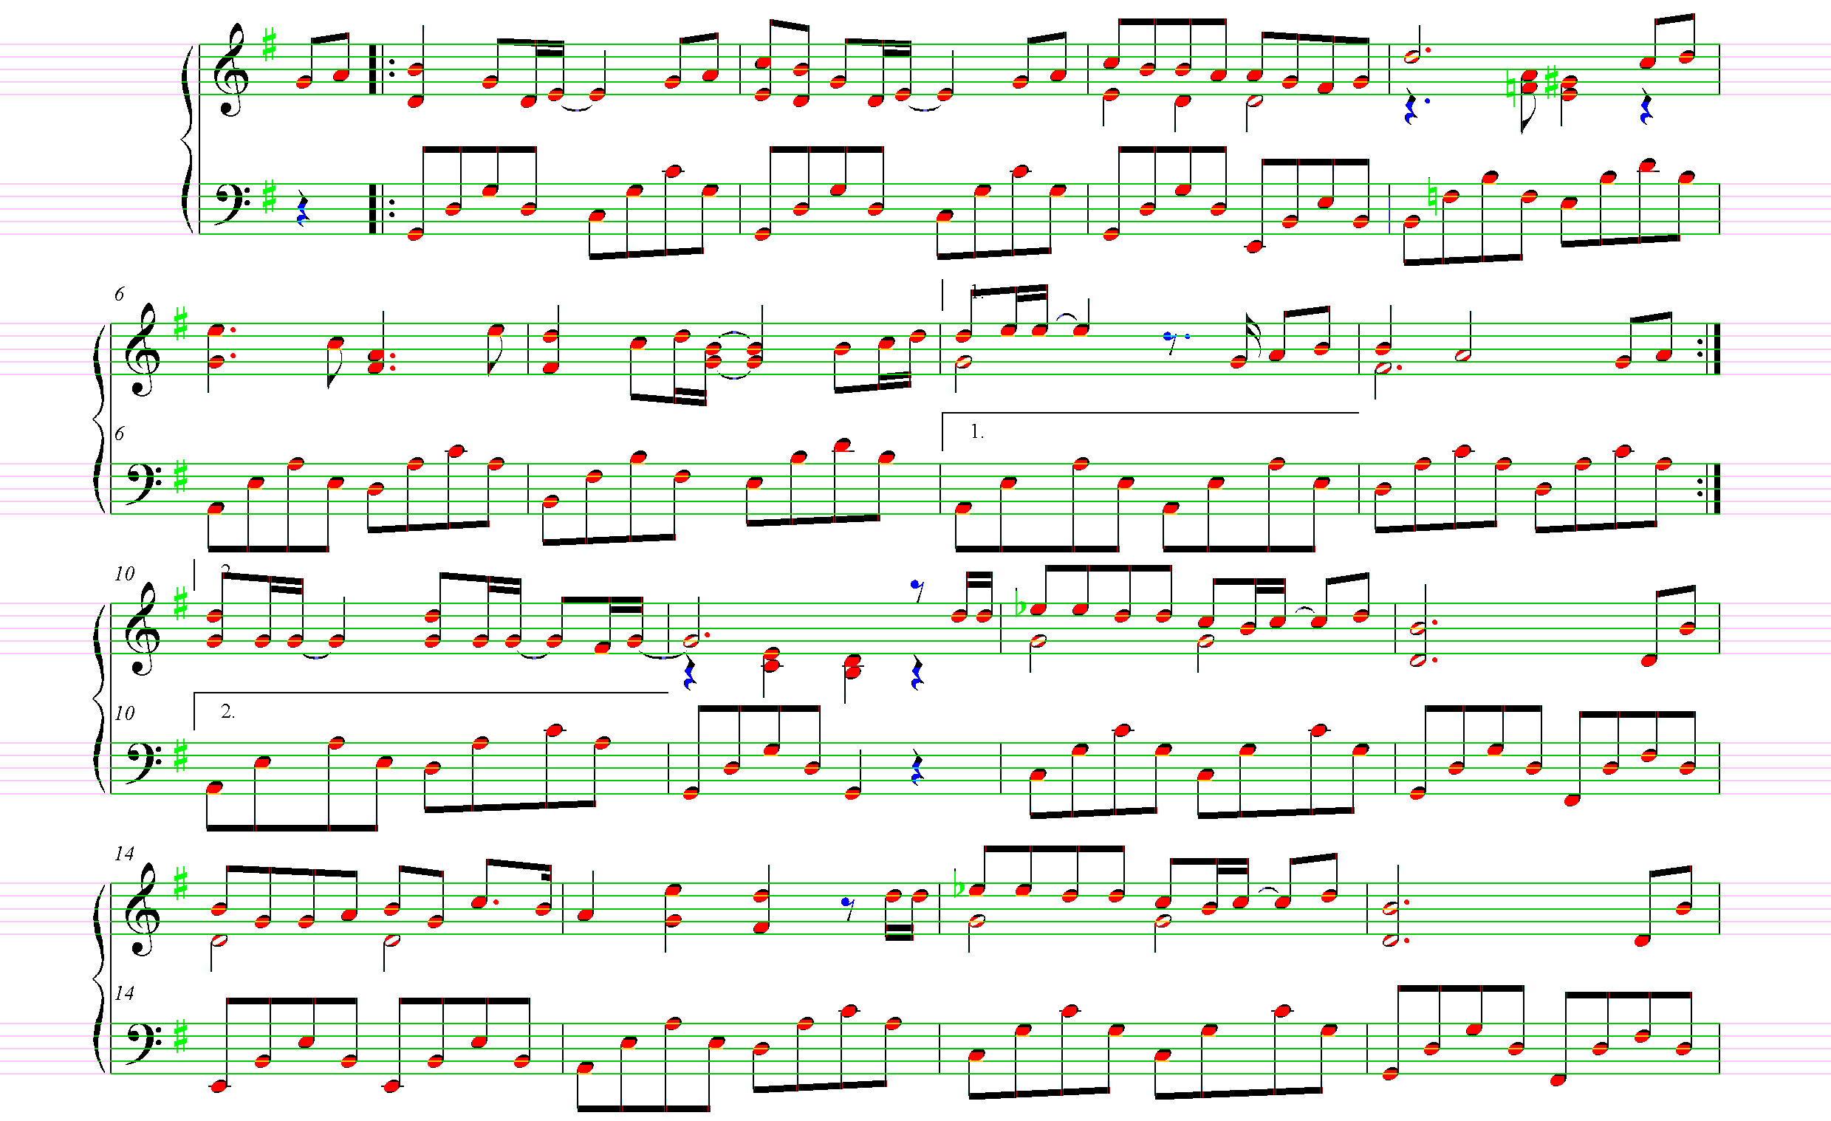
Main Function :Final Result of Detection

Slide 18
Main Function: Process Music Scores
Play the Processed Score

Slide 19
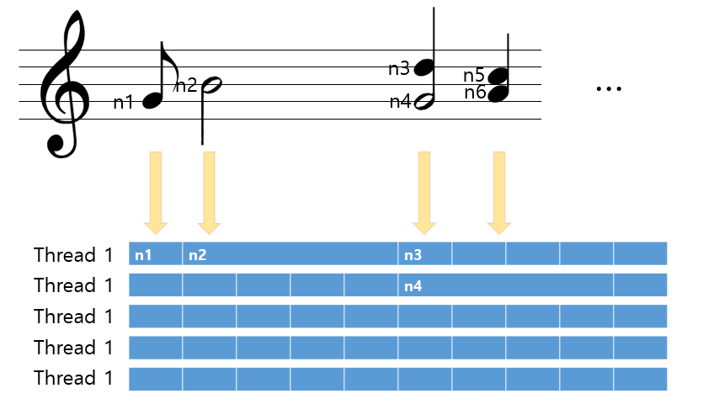
Midi Function: Play the Processed Score
0
1
2
3
4
…

Slide 20
Design : Class
Feature | File Name | Description
UI & Main Function | PerfectPitch-UI.cpp | It is the main function of the program and makes the GUI of it by using MFC (C++ Library
 | PerfectPitch-UIDlg.cpp
Processing Music Sheet | Pretreatment.cpp | Binarization, detect 5 lines and remove duplicate pixels of the line
 | LinearScore.cpp | It cuts the music sheets into staves by right hand score and left hand score.
Detect the Notes, Calculate and Push | ScoreProcessor.cpp | Detect all the music notes and beats by template matching and calculating pixels
 | Accord.cpp | Find the exact pitch of music notes by calculating the distance of pixel with the 5 lines
 | Score.cpp | Push all the scores in to the threads
Playing Music | Thread.cpp | Play music.
 | Midi.cpp | C++ library to produce the musical sound

Slide 21
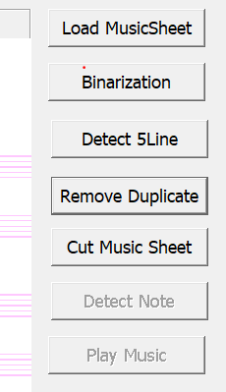
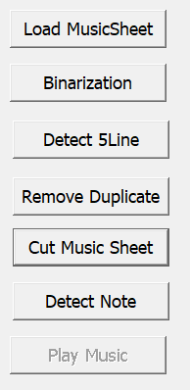
Design : UI

Slide 22
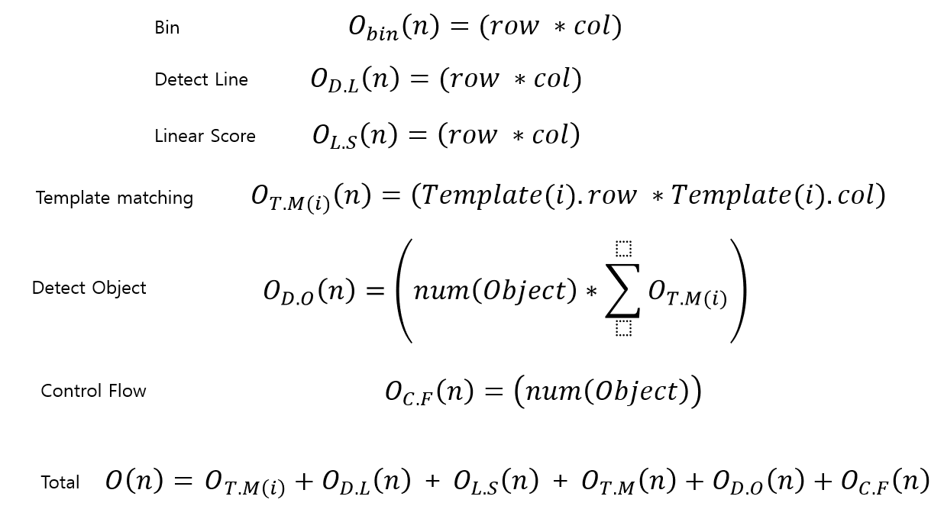
Performance : Time Complexity

Slide 23
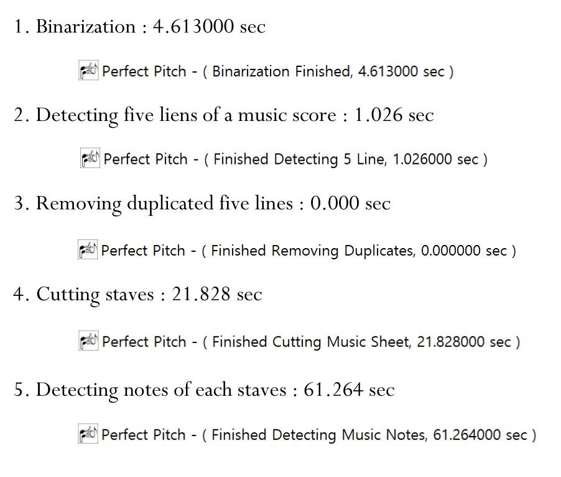
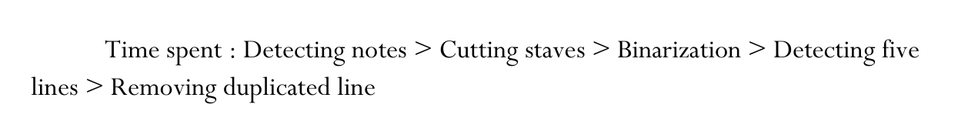
Performance : Spending Time of the Program

Slide 24
Demo

Slide 25
THANK YOU
Team 02 16 (Perfect pitch)
20141001 이지호 20141261 송제웅
20164542김선재 20145315 심지선
2018. 12. 08 (SAT)

